Slide 1
Field Technique
Chapter 9

Slide 2
Introduction
Field epidemiology is an intensive course that cover the essential knowledge, skill and abilities necessary to conduct an epidemiologic field investigation.
The application of theories and principle of epidemiology in an actual field situation is known as field epidemiology.
It is the systematic and discipline process of measuring various field circumstances in which disease or condition tends to occur or not .

Slide 3
Introduction
It cover various field activities such as epidemic or outbreak investigation, conduction of observational intervention studies

Slide 4
Purpose of field epidemiology
To identify the magnitude of problem in population in terms of its distribution
To establish interrelationship between the variables and generate hypothesis
To establish causal relationship

Slide 5
Uses of field epidemiology
As planning tool; for assessing the population problem, the trend of the problem to compare the problems to each other and designing intervention
As management tool; in the evaluation programs , to monitor the progress of the program, assess output, surveillance of disease and to investigate of outbreak of disease in the population
As advocacy tool; used to advocate policy and interventional choices
Contribution to science: it observe casual relationship

Slide 6
Field technique
It includes various procedures starting from study topic selection, formulation of research question, statement of problems, literature reviews, study objectives, conduction of test instrument, ethical clearance, proposal approval and conduction of research.
Field technique starts with problem identification and proposal development

Slide 7
steps
Problem identification
Proposal development
Method of collecting information
-Interview
-Observation

Slide 8
Problem identification
First step of field technique
In epidemiological study, the field work originates with identify health problem and investigator’s interest on it.
Problem may identify from the sources of;
Experience and clinical fieldwork
Social issues
Either epidemiological, public health, environmental, community development or national health policy perspective (lecture)
Ideas or suggestion from others

Slide 9
Problem identification
Experience and clinical fieldwork:
Everyday experience is a rich source of ideas
If we are curious during our work area many ideas may arise on the way of work that helps how about the things could be improved
Social issues: suggested more or less by present world social or political issues of reverence to the health care service eg; gender equality in health care

Slide 10
Problem identification
Literature;
formulating research problem often comes from reading the literature
Regularly reading help to formulate
Book, published or non published report, articles, research journal, theories
Idea or suggestions from others;
External sources also may provide research idea
Funding agencies or organizations often identify topic on research proposals are encouraged to apply
By discussion; peer, expertise, advisors, expertise with advance skills and ideas
Professionals conference (excellent opportunities)

Slide 11
Problem identification
Research problem should be:
Specific
Measurable
Achievable
Realistic
Time bound
Interested to research
Nobility
Manageable limits
Relation between two or more variables
Clear and unambiguously

Slide 12
SMART
Specific: Well defined, clear, and unambiguous
Measurable: With specific criteria that measure your progress towards the accomplishment of the goal
Achievable: Attainable and not impossible to achieve
Realistic: Within reach, realistic, and relevant to objective
Timely: With a clearly defined timeline, including a starting date and a target date. The purpose is to create urgency.

Slide 13
Identifying the problem
Is the problem a current and timely one or does problem exist now?
Does the problem have life-threating or serious morbidity
Does the problem affect or potentially affect a large number of people?
Does the problem related to on-going program activities?
Does the problem have broad social, economic, political or health implication?
Is the problem viewed as a concern by many different people.

Slide 14
Criteria for prioritization
Relevance
Avoidance to duplication
Urgency of data needed
Political acceptability
Feasibility of study
Applicability of possible result or recommendations
Ethical acceptability

Slide 15
2. Proposal Development
The development of proposal is a written document or blue print or plan for the research investigation that includes the major elements identified research problem, objective, conceptual framework of the study, systematic methods and techniques of data collection
A research proposal is similar in a number of ways to a project proposal; however, a research proposal addresses a particular project of academic or scientific research.

Slide 16
2. Proposal Development
Research proposals contain extensive literature reviews
Rational for the study- the proposal must be describe a detailed methodology

Slide 17
2.Proposal Development
Title of the study Introduction Background Significance of the study Statement of the problem Research objective Hypothesis/ research question Operational definition Variables Conceptual framework Limitation of the study 3. Review of literature Review of related literature Summary of literature review | 4. Research methodology Research design Population of the study Population sampling method/technique and sample size Setting of the study Inclusion criteria Development of instruments Pre-testing of instrument Validity and reliability Date collection procedure Ethical consideration Data analysis procedure Budget and work plan for completing the study

Slide 18
2.Proposal Development
Data analysis and interpretation
Major finding, discussion, conclusion and recommendation
Discussion
Conclusion
Recommendation; study area, future study
Implication of the study
Strength and weakness of the study
Plan of dissemination
Reference; Journal, books and internet
Appendix; Questionnaire, guidelines, work plan and permission letter

Slide 19
Ethical consideration
Fundamental Research ethics/ principles
Respect for person: protect from exploitation of their vulnerability
Beneficence: need to minimizing the risk associated with research
Justice: it requires a commitment to ensuring a fair distribution of the risk and benefits resulting from research
Respect for communities: to respect the value and interest of the community in research and wherever possible to protect the community from harm.

Slide 20
Right to participation
Confidentiality
Anonymity
The voluntary participation

Slide 21
Inform consent
is a process for getting permission before conducting a healthcare intervention on a person, or for disclosing personal information.
is the process of providing an individual with sufficient understandable information regarding his or her participation in a research project
Is a mechanism for ensuring that people understand what it means to participate in a particular research study so they can decide in a conscious, deliberate way whether they want to participate
Important tool for ensuring respect for person during research

Slide 22
confidentiality
refers to a condition in which the researcher knows the identity of a research subject, but takes steps to protect that identity from being discovered by others.
Most human subjects research requires the collection of a signed consent agreement from participants, and the collection of other personally identifiable data, and thus researchers are aware of the identity of their subjects.
In such cases, maintaining confidentiality is a key measure to ensure the protection of private information.

Slide 23
confidentiality
Having consented to an initial invasion of privacy by supplying information research participants has the right to maintain control over any further release of those data
Strict confidentiality will be maintain during the collection, storage and use of the data
Confidentiality refers to the researcher’s responsibility to protect all data gathered within the scope of the project from being disclose to other

Slide 24
Anonymity
is a condition in which the identity of individual subjects is not known to researchers. (person's identity is unknown)
anonymity refers to data collected from respondents who are completely unknown to anyone associated with the survey.
That is, only the respondent knows that he or she participated in the survey, and the survey researcher can not identify the participants.
More often, anonymity refers to data collected in surveys in which the respondents are de-identified and all possible identifying characteristics are separated from the publicly available data.

Slide 25
Regulatory bodies
It may need to take permission from regulatory bodies for conducting research, mainly when subject are human beings
There are regulatory bodies in most of the countries which grant permission after considering ethical issues of the study

Slide 26
Regulatory bodies
An institutional review board (IRB), also known as an independent ethics committee (IEC), ethical review board (ERB), or research ethics board (REB), is a type of committee that applies research ethics by reviewing the methods proposed for research to ensure that they are ethical.
Such boards are formally designated to approve (or reject), monitor, and review biomedical and behavioral research involving humans.
They often conduct some form of risk-benefit analysis in an attempt to determine whether or not research should be conducted.

Slide 27
Regulatory bodies
The purpose of the IRB is to assure that appropriate steps are taken to protect the rights and welfare of humans participating as subjects in a research study.
Along with developed countries, many developing countries have established national, regional or local Institutional Review Boards in order to safeguard ethical conduct of research concerning both national and international norms, regulations or codes.

Slide 28
Protection from the risk and injury
Researcher have are responsibility to ensure that their participants are not directly and indirectly harmed in the research
Safety; physical and non-physical
Qualitative research required very careful monitoring (Open ended interview)
When questioning in sensitive area the researcher must set the limits for what is ethical
Clinical setting

Slide 29
Method of collecting information
Data collection is a crucial stage in the planning and implementation of a study
If collected data are; superficial, biased or incomplete, data analysis become difficult and research report will be of poor quality
Data should be collected according to objective of the study
If data are collected haphazardly, it will be difficult to answer our research questions in conclusive way

Slide 30
Data collection of technique
Using available information
Administration written questionnaires
Project techniques , mapping, scaling
Observing
Interviewing
Focus group

Slide 31
Data collection of technique
1.Using available information
Large amount of data has already been collected by other
Eg: health information system data, census data, unpublished report and publications in archives and libraries or in office at the various level of health related service
Use of key informants is another important techniques (could be knowledgeable community leader, health staff at various level)
Other source of data are; newspapers and published care histories

Slide 32
Data collection of Technique
Advantage of using existing data is inexpensive
However, it is sometimes difficult to gain access to the records or report required, and the data may not always be complete and precise enough, or too disorganized

Slide 33
Data collection of Technique
2. Administration written questionnaires
Written questions are presented that are to be answered by the respondents in written form
It also referred to as self- administered questionnaire
closed ended/ open ended
Multiple choice question/Multiple response question
By mail, hand- delivering questionnaire to respondents and collecting them later, hand delivering questionnaires to respondents and collecting them later

Slide 34
Data collection of techniques
Types of Questionnaire
structured
It consist of close ended questions ie all possible answer are listed alongside will question
Participant should mark the or select according to best response
Unstructured
It consist of open ended question ie the possible response varies from participant to participant
Applicable for those type of data that requires in-depth knowledge
Respondent should write in blank space

Slide 35
Date collection
3. Projective techniques: for this techniques he/she ask an informant to react to some kind of visual or verbal stimulus. eg; presentation of hypothetical question
If I were to discover that my neighbor had TB, I would…..
If my wife were to propose that use condoms, I would
Suppose your child suffer from diarrhea, what would you do?
Easily combine with semi-structured interviews or written questionnaire; very useful in FDG to get people’s opinion on sensitive issue

Slide 36
Data collection technique
4. Observation: it refer to a systematically selecting, watching and recording behavior and characteristics of living beings objects
Observation is purposeful, systematic and selective way of watching and listening to an interaction or phenomenon as it takes place
Observation can be; open/ concealed
Observation checklist

Slide 37
Data collection cont..
Types of observation
Participant observation
Non- participant observation;
Does not disclose his/her identity or purpose
Does not interact
Sit quietly in the corner observing the setting

Slide 38
Data collection cont..
Advantage
More accurate information on the behavior and action in comparison to other method
Participatory observation allows researcher to gain experience to learn situation
Disadvantage
Biasness can occur
Ethical problem may arise if observation is done without informing the respondent

Slide 39
Data collection cont…
5. Interview: is a data-collection technique that involves oral questioning of respondents, either individually or as a group. Answers to the questions posed during an interview can be recorded by writing or by type-recording the response or by combination f the both.
Definition: face to face verbal interchange in which one person, that is the interviewer attempt to elicit information or expression of opinion, belief from another person or person. It could be structure interview, semi-structured interview or un-structured (non-structured) interview.

Slide 40
Interview
Structured interview is:
Well-defined pattern is followed, similar to questionnaire
Pre-determined set of questions, using the same wording and order of questions as specified in the interview schedule
Written list of question (open or close)
For person to person
For telephone or other

Slide 41
Interview
Unstructured interview: usually applicable for obtaining the information that is very personal
Also known as in-depth interview
Interview develops a interview guide, within which interview conducted
Within the guideline interview formulates questions spontaneously during an interview
Can be carried out group interview or focus group interview
Extremely useful when little is known about the situation
Interviewer bias
Training is important so that the interviewer knows when and how to survey.

Slide 42
Interview
Developing interview guideline
Clearly state the purpose of interview for study
Identify information
Choose the type of interviews for the study
Decide the topic/ sub-topics to be covered
Prepare and include some open ended questions under each topic
Sequence of question (Main question, follow up question)

Slide 43
6.Focuse group discussion

Slide 44
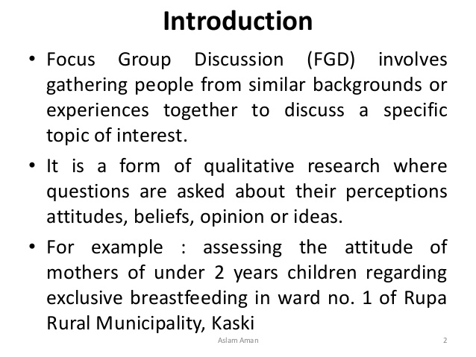

Slide 45
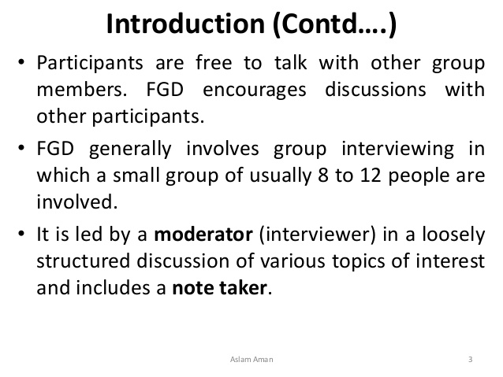

Slide 46
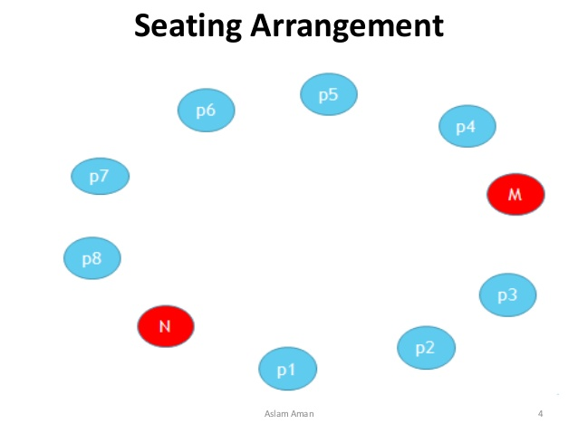

Slide 47
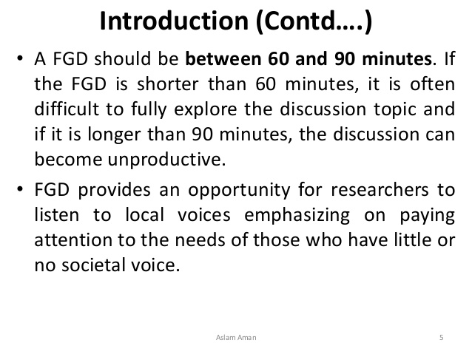

Slide 48
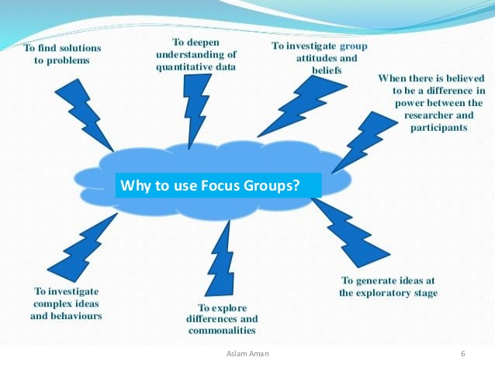


Slide 49
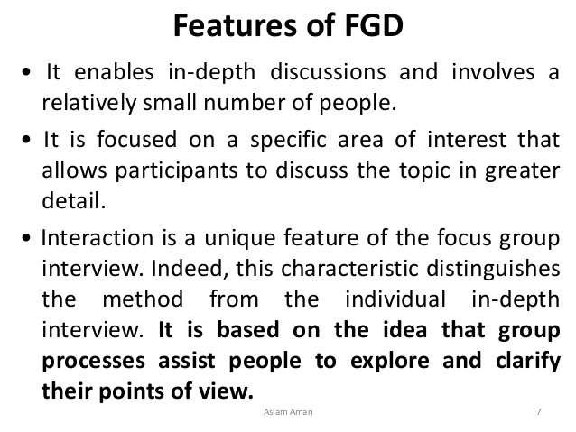

Slide 50
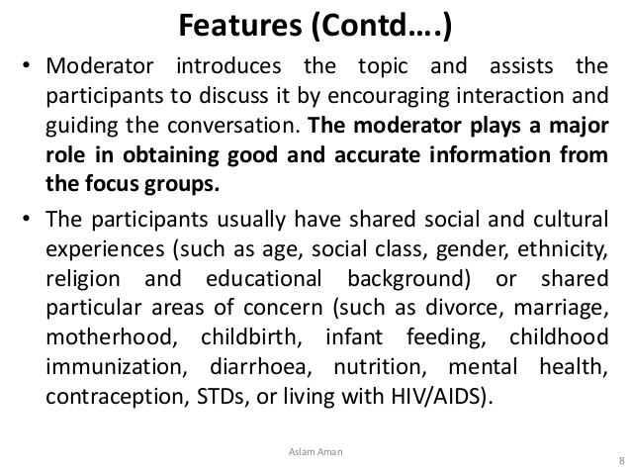

Slide 51
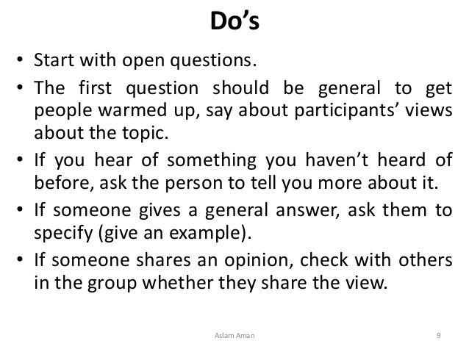

Slide 52
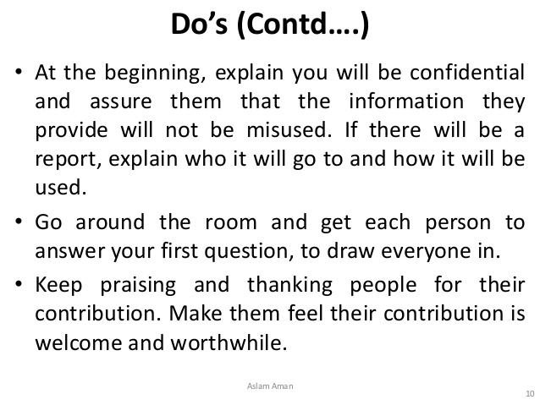

Slide 53
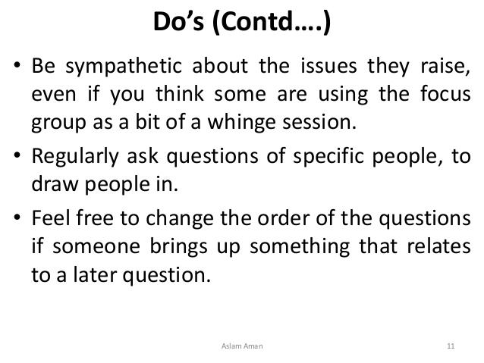

Slide 54
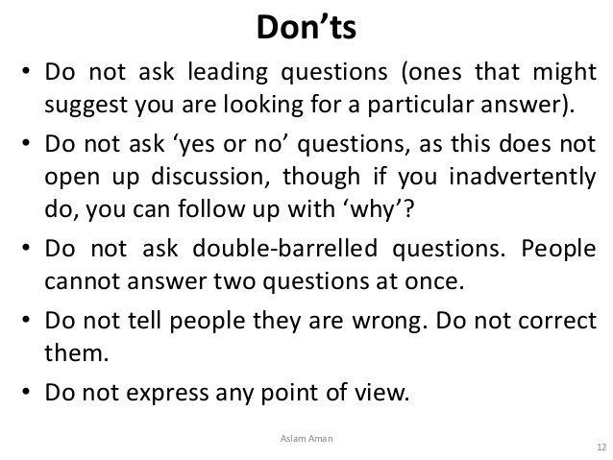

Slide 55
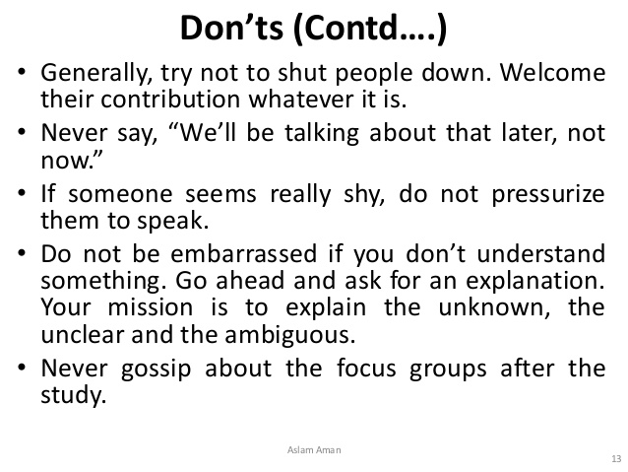

Slide 56
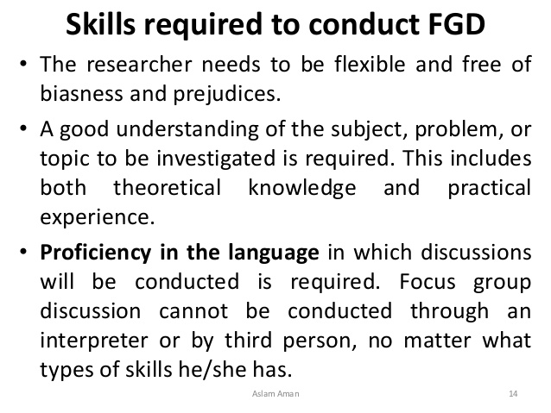

Slide 57
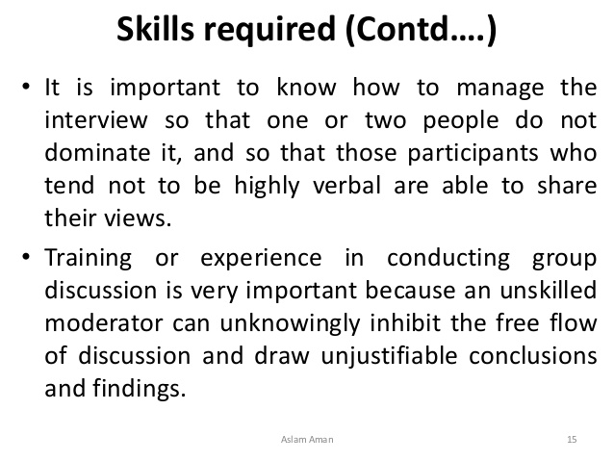

Slide 58
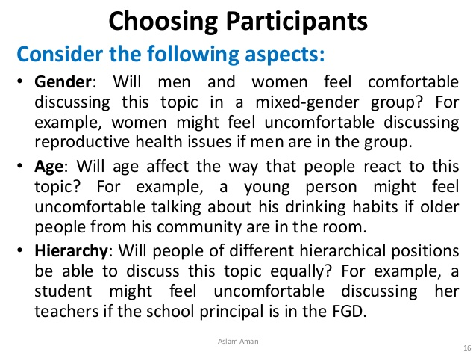

Slide 59
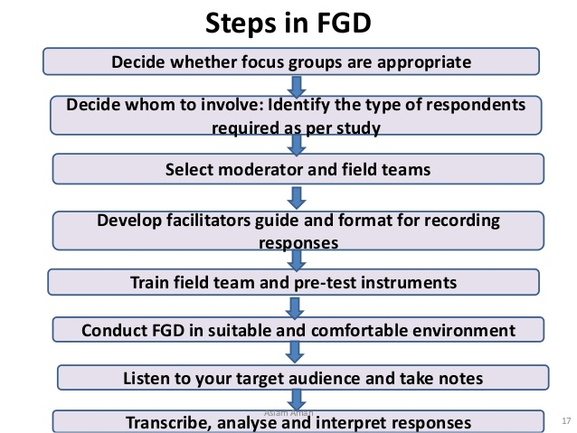

Slide 60
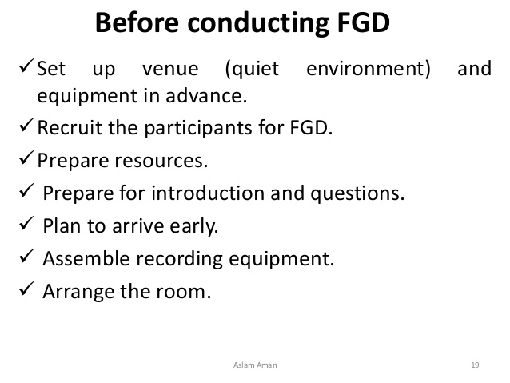

Slide 61
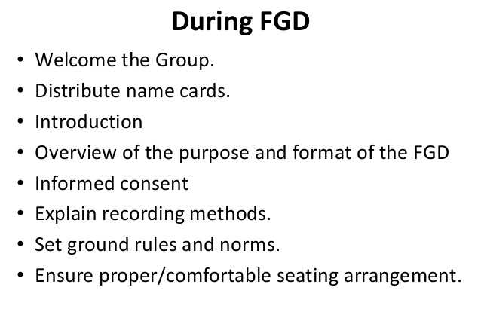

Slide 62
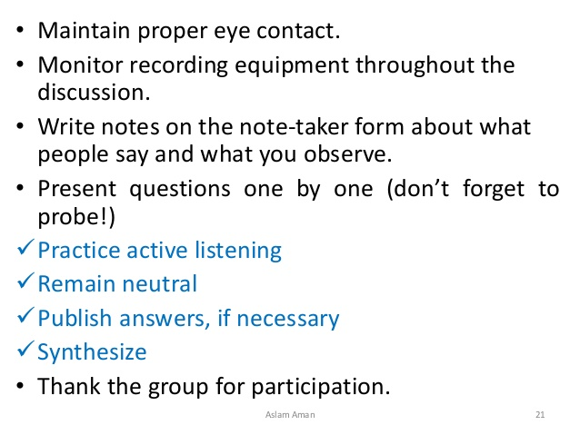

Slide 64


Slide 65


Slide 66
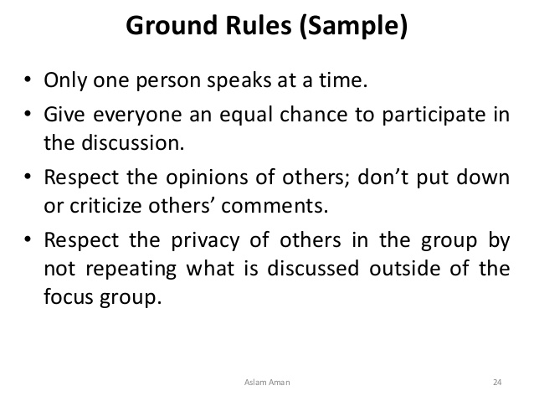

Slide 67
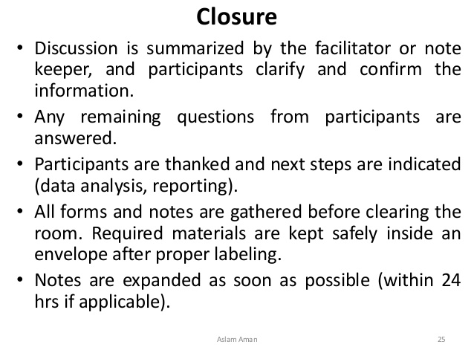

Slide 68
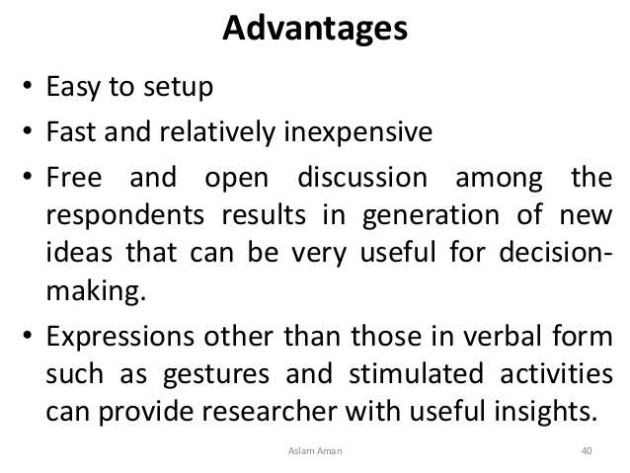

Slide 69
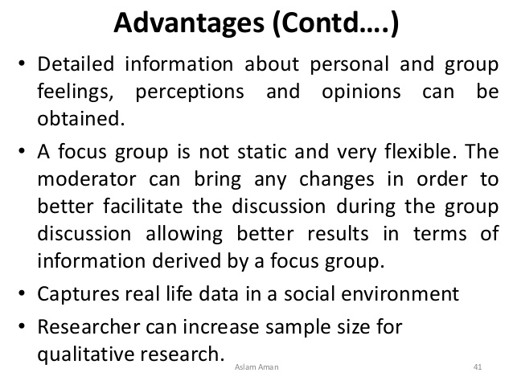

Slide 70
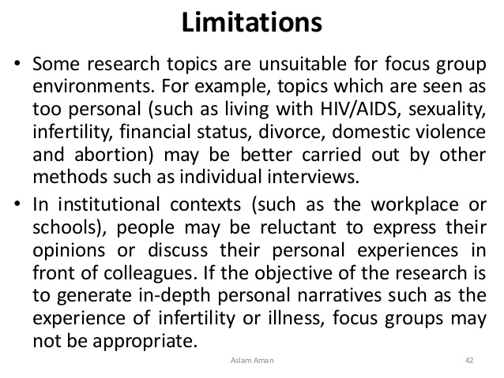

Slide 71
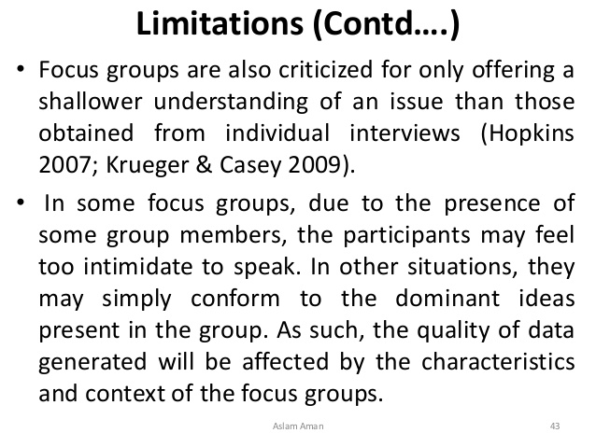

Slide 72
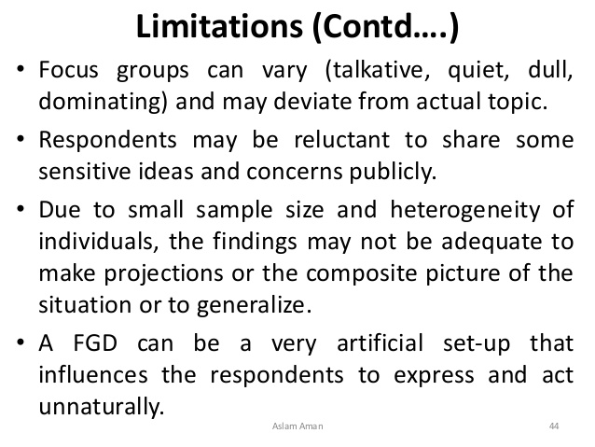

Slide 73
